Slide 1
Trees
Lecture

Slide 2
Set
an abstract data type that can store certain values, without any particular order, and no repeated values. It is a computer implementation of the mathematical concept of a finite set. Unlike most other collection types, rather than retrieving a specific element from a set, one typically tests a value for membership in a set.

Slide 3
Efficient Set Representation Using Bit Patterns
enumerable sets
we’ll use ‘A’ through ‘Z’
A | B | C | D | E | F | G | H | I | J | K | L | M | N | O | P | Q | R | S | T | U | V | W | X | Y | Z
0 | 0 | 0 | 0 | 0 | 0 | 0 | 0 | 0 | 0 | 0 | 0 | 0 | 0 | 0 | 0 | 0 | 0 | 0 | 0 | 0 | 0 | 0 | 0 | 0 | 0

Slide 4
Representing a Set as a Bit Pattern¹
typedef struct {
unsigned member;
} SET;
SET create(void)
{
SET result;
result.member = 0;
return result;
}
SET add(SET *s, char item)
{
int letter;
letter = (int) pow(2,(item-65));
s->member = s->member + letter;
return *s;
}

Slide 5
Representing a Set as a Bit Pattern²
SET intersection(SET s1, SET s2)
{
SET s3;
s3.member = s1.member & s2.member;
return s3;
}
SET union(SET s1, SET s2)
{
SET s3;
s3.member = s1.member | s2.member;
return s3;
}

Slide 6
Limitations of Representing a Set as a Bit Pattern
There are a limited number of elements that can be in the domain of the set – a variable of type long has 8 bytes (on our machines), or 64 bits.
We cannot explicitly label the elements – we need to map the position in the bit pattern to the label
Too limited for many “real world” situations that would lend themselves to sets

Slide 7
Representing a Set as a List
Nodes are elements

Slide 8
Using a Linked List to represent a Set
head
Andy
EMPTY
Sue
Becky
{Andy, Sue, Becky}

Slide 9
Operations on Sets
setCreate(S): creates a new, initially empty set structure.
setAdd(S,x): adds the element x to S, if it is not present already.
setContains(S,x): checks whether the value x is in the set S, return 0 or 1.
setEnumerate(S): displays a list containing the elements of S
setUnion(S,T,Z): returns the union of sets S and T in set Z.
setIntersection(S,T,Z): returns the intersection of sets S and T in set Z.
  typedef struct SET_ELEMENT {
  char member[64];
  struct SET_ELEMENT *next;
  } SET_ELEMENT;
  typedef struct SET {
  SET_ELEMENT *head;
  } SET;

Slide 10
setCreate(S)
/******************************************/
/* create an empty set */
/******************************************/
void setCreate(SET *setName)
{
setName->head = malloc(sizeof(SET_ELEMENT));
setName->head->next = NULL;
strcpy(setName->head->member,"END OF LIST");
return;
}
head
END OF LIST

Slide 11
setAdd(S,x)
void setAdd(SET *s, char item[])
{
SET_ELEMENT *node;
if(!setContains(s,item)){
node = malloc(sizeof(SET_ELEMENT));
strcpy(node->member,item);
node->next = s->head;
s->head = node;
}
else {
printf("attempted to add duplicate value: %s!\n",item);
}
return;
}
END OF LIST
Becky
head

Slide 12
setContains(S,x) -> {0,1}
/******************************************/
/* returns a one if the item in in the */
/* set, and a zero otherwise */
/******************************************/
int setContains(SET *s, char item[])
{
SET_ELEMENT *temp;
temp = s->head;
while(temp->next != NULL) {
if(strcmp(temp->member,item)==0) {
return 1;
}
temp = temp->next;
}
return 0;
}

Slide 13
setEnumerate(s)
/******************************************/
/* displays the members of the set */
/******************************************/
void setEnumerate(SET s)
{
SET_ELEMENT *temp;
temp = s.head;
while(temp->next != NULL) {
printf("SET: %s\n",temp->member);
temp = temp->next;
}
return;
}

Slide 14
setUnion(S,T,Z)
/***************************************************************/
/* produces the union of two sets by copying the first set to */
/* the new set and then adding elements from the second set to */ /* new set (duplicates aren't added) */ */**************************************************************/
void setUnion(SET *s1, SET *s2, SET *sNew)
{ SET_ELEMENT *temp;
temp = s1->head;
while(temp->next != NULL) {
setAdd(sNew,temp->member);
temp = temp->next;
}
temp = s2->head;
while(temp->next != NULL) {
setAdd(sNew,temp->member);
temp = temp->next;
}
}

Slide 15
setIntersection(S,T,Z)
/******************************************/
/* produces the intersection of two sets */
/* by enumeraitng the first set, and if */
/* the item is also contianed in the */
/* second set, it is added to the new set */
/******************************************/
void setIntersection(SET *s1, SET *s2, SET *sNew)
{
SET_ELEMENT *temp;
temp = s1->head;
while(temp->next != NULL) {
if(setContains(s2,temp->member)) {
setAdd(sNew,temp->member);
}
temp = temp->next;
}
return;
}

Slide 16
Demo/Testing
Often requires extra code to demonstrate or test behavior
Role is generally called test automation

Slide 17
A Function to Randomly Generate Strings
void generateString(char randomString[], int length)
{ int randomNumber,temp,slen; char letter;
randomString[0]='\0';
slen = 0;
while(slen < length) { // loop until you've built a 'length' long string
randomNumber = (int) rand();
while(randomNumber > 0) { // will generate 4 or 5 characters
temp = randomNumber % 100; // pull off the last 2 digits
randomNumber = randomNumber / 100;
letter = temp % 26;
randomString[slen] = letter + 65; // last 2 digits to [A..Z]
slen = slen + 1;
randomString[slen] = '\0'; // terminate the substring so far
}
randomString[length] = '\0'; // terminate the final random string
}
return;
}

Slide 18
Using the LL Library for Set Operations – demo 1
void main(void)
{ SET set1, set2; char anItem[64]; int i;
setCreate(&set1);
setCreate(&set2);
for(i=0;i<10;i++) {
generateString(anItem,32);
setAdd(&set1,anItem);
if((i % 2) == 0) {
setAdd(&set2,anItem);
}
}
setAdd(&set2,"NEW");
setAdd(&set2,"BEGINNINGS");
printf("set1 is:\n"); setEnumerate(set1);
printf("set2 is:\n"); setEnumerate(set2);
}

Slide 19
Using the LL Library for Set Operations – demo 2
void main(void)
{
SET set1, set2, set3, set4; char anItem[64], searchString[64]; int i;
setCreate(&set1);
setCreate(&set2);
for(i=0;i<10;i++) {
generateString(anItem,32);
setAdd(&set1,anItem);
if((i % 2) == 0) {
setAdd(&set2,anItem);
}
}
setAdd(&set2,"NEW");
setAdd(&set2,"BEGINNINGS");
printf("set2 is:\n");
setEnumerate(set2);
printf("Enter search string ");scanf("%s",searchString);
printf("Result of Search: %d\n"setContains(&set1,searchString));
}

Slide 20
Using the LL Library for Set Operations – demo 3
void main(void)
{
SET set1, set2, set3, set4; char anItem[64],searchString[64];
int i;
setCreate(&set1); setCreate(&set2);
for(i=0;i<10;i++) {
generateString(anItem,32);
setAdd(&set1,anItem);
if((i % 2) == 0) {
setAdd(&set2,anItem);
}
}
setAdd(&set2,"NEW"); setAdd(&set2,"BEGINNINGS");
printf("set2 is:\n");
setEnumerate(set2);
setCreate(&set3);
setIntersection(&set1,&set2,&set3);
setEnumerate(set3);
}

Slide 21
Using the LL Library for Set Operations – demo 4
void main(void)
{
SET set1, set2, set3, set4; char anItem[64],searchString[64];
int i;
setCreate(&set1); setCreate(&set2);
for(i=0;i<10;i++) {
generateString(anItem,32);
setAdd(&set1,anItem);
if((i % 2) == 0) {
setAdd(&set2,anItem);
}
}
setAdd(&set2,"NEW"); setAdd(&set2,"BEGINNINGS");
printf("set2 is:\n");
setEnumerate(set2);
setCreate(&set3);
setUnion(&set1,&set2,&set3);
setEnumerate(set3);
}

Slide 22
Gets Slow as the Set Size Grows
Many operations depend on setAdd(), which in turn depends on:
  if(!setContains(s,item)){
  node = malloc(sizeof(SET_ELEMENT));
  strcpy(node->member,item);
  node->next = s->head;
  s->head = node;
  }
If the element is not already in the set, the entire list must be checked
If you add 100,000 elements …

Slide 23
A Smarter Way to Store the Elements for Faster Retrieval
A linear linked list goes through every node in the list
When you go to add an element to the list, the element can be less than, equal to or greater than the node you want to connect it to
We can make it more efficient by having nodes separate where they put the entries with smaller values from where they put the ones with larger values

Slide 24
Defining a Binary Tree
typedef struct SET_ELEMENT {
char member[64];
struct SET_ELEMENT *less;
struct SET_ELEMENT *more;
} SET_ELEMENT;
typedef struct SET {
SET_ELEMENT *head;
} SET;

Slide 25
To Add an Item
void setAdd(SET *s, char item[])
{
SET_ELEMENT *node, *curr, *last;
node = malloc(sizeof(SET_ELEMENT));
strcpy(node->member,item); node->less = NULL; node->more = NULL;
curr = s->head;
last = curr;
while(curr != NULL) {
last = curr;
if(strcmp(item,curr->member)==0) return;
else if(strcmp(item,curr->member)<0) curr = curr->less;
else if(strcmp(item,curr->member)>0) curr = curr->more;
}
if(strcmp(item,last->member) < 0) last->less = node;
else last->more = node;
return;
}

Slide 26
To Discover if an item is a member of the set
int setContains(SET *s, char item[])
{
SET_ELEMENT *curr;
curr = s->head;
while(curr != NULL) {
if(strcmp(item,curr->member)==0) {
return 1;
}
else if(strcmp(item,curr->member)<0) {
curr = curr->less;
}
else {
curr = curr->more;
}
}
return 0;
}

Slide 27
Enumerating Items
/******************************************/
/* displays the members of the set */
/******************************************/
void setEnumerate(SET_ELEMENT *s)
{
printf(">>%s\n",s->member);
if(s->less != NULL) setEnumerate(s->less);
if(s->more != NULL) setEnumerate(s->more);
return;
}

Slide 28
Recursion
recursion is one of the central ideas of computer science
the solution to a problem is a series of solutions to smaller instances of the same problem
  printf(">>%s\n",s->member);
  if(s->less != NULL) setEnumerate(s->less);
  if(s->more != NULL) setEnumerate(s->more);
  return;

Slide 29
Recursive Definitions
f(0) = 0
f(n) = n + f(n-1) for n > 0
f(6) = 6 + f(5)
f(5) = 5 + f(4)
f(4) = 4 + f(3)
f(3) = 3 + f(2)
f(2) = 2 + f(1)
f(1) = 1 + f(0)

Slide 30
Recursive Definitions
f(0) = 0 Base case
f(n) = n + f(n-1) for n > 0 Recursive case
f(6) = 6 + f(5)
f(5) = 5 + f(4) the Base case breaks
f(4) = 4 + f(3) the chain of recursion
f(3) = 3 + f(2)
f(2) = 2 + f(1)
f(1) = 1 + f(0)

Slide 31
Set Intersection, recursively
void intersectionTraversal(SET_ELEMENT *se1, SET *s2, SET *sNew)
{
if(setContains(s2,se1->member)==1) setAdd(sNew,se1->member);
if(se1->less != NULL) intersectionTraversal(se1->less,s2,sNew);
if(se1->more != NULL) intersectionTraversal(se1->more,s2,sNew);
return;
}
void setIntersection(SET *s1, SET *s2, SET *sNew)
{
intersectionTraversal(s1->head,s2,sNew);
return;
}

Slide 32
TREES

Slide 33
Trees
A data structure with a root node
That node can have 0-n children – that is, nodes that it links to
Each child node is the root of a subtree
A node that has no children is called a leaf

Slide 34
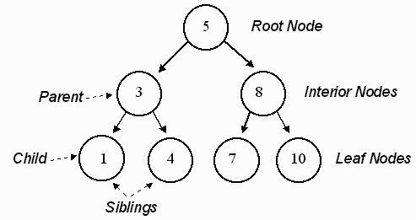
Some Trees and Terminology

Slide 35
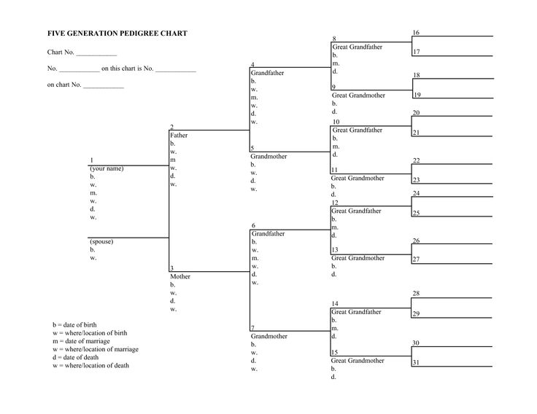
Another Kind of Tree

Slide 36
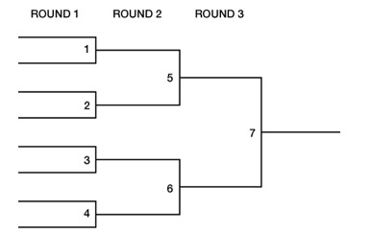
A Tournament Tree

Slide 37
Some Definitions
Root - the top node in a tree.
Child - a node directly connected to another node when moving away from the Root.
Parent –the converse notion of a child.
Siblings - a group of nodes with the same parent.
Descendant - a node reachable by repeated proceeding from parent to child.
Ancestor - a node reachable by repeated proceeding from child to parent.
Leaf - a node with no children.
Degree - the number of sub trees of a node.
Edge - the connection between one node and another.
Path - a sequence of nodes and edges connecting a node with a descendant.
Level - the level of a node is defined by 1 + (the number of connections between the node and the root).
Height of node - the height of a node is the number of edges on the longest path between that node and a leaf.
Height of tree - the height of a tree is the height of its root node.
Depth - the depth of a node is the number of edges from the node
to the tree's root node.

Slide 38
Program Assignment
Your uncle Buck, the CEO of Big Cheese Inc., has asked you to write a computer program that produces an organization chart for the company.
He would like the user to create a text file named ‘higherarchy’ in the local directory that contains, on each line, a person’s name, and the names of that person’s direct reports. For example:
  Buck Sue Jim Sara
  Sue Fred Tom Bob
  Jim Mary Adam
  Tom Billy Todd Mark
  Bob Sandy
  Sandy George Marvin Karen
Since uncle Buck is superstitious he never hires anyone with the same name as someone who already works at Big Cheese, and to avoid having his employees know too much about what is going on, no one has more than four direct reports.
The next page shows what the organization chart should look like. Indent between three and five spaces per level.

Slide 39
The Organization Chart
you can get fancy if you want
Buck
Sue
Fred
Tom
Billy
Todd
Mark
Bob
Sandy
George
Marvin
Karen
Jim
Mary
Adam
Sara

